Slide 1
Improving healthcare through evidence-based guidance
Professor Gillian Leng, CBE
Deputy Chief Executive, NICE

Slide 2

Areas to cover
NICE’s role
Assessing safety and effectiveness
Evaluating the potential of digital technologies
Supporting pathways of care
“Our purpose is to help improve the quality, sustainability and productivity of health and social care”

Slide 3

Core principles of NICE guidance
Comprehensive evidence base – not just RCTS
Expert input - from clinicians, economists etc
Patient and public involvement
Independent advisory committees
Genuine consultation with all stakeholders
Regular review and updating
Open and transparent process – meetings held in public.

Slide 4

The NICE portfolio
Advice
Interventional procedures
Health
New Medicines
Guidelines
Appraisals
Public Health
NICE
New Medical
Technologies &
Diagnostics
Social Care
Quality standards
Indicators

Slide 5

Interventional procedures guidance
Guidance as to whether interventional procedures used for diagnosis or treatment are safe enough and work well enough for routine use in the NHS
Procedures used for diagnosis or treatment that involve:
Making a cut or hole to gain access to the inside of a patient’s body, or
Gaining access to a body cavity without cutting into the body, or
Using electromagnetic radiation (which includes X-rays, lasers, gamma-rays and ultraviolet light).

Slide 6
IP guidance to NHS in England, Wales, NI and Scotland
MAY BE USED
with the normal arrangements for consent and audit
DO NOT USE
not safe & efficacious enough for use
MAY BE USED
with special arrangements for consent, clinical governance and audit or research
+ information for the public

Slide 7
Increasing uptake of medical technologies
Ideas to improve adoption:
‘Which’ guides
Funding requirements
AAC - 7 products identified. All been developed in the UK and approved by NICE. Will receive an extra £2m funding and system-wide support to help 500,000 patients access new treatments and save the NHS £30 million.
HealthTech Connect
AAC Technology | Description
Placental growth factor (PIGF) | Testing for ruling out suspected pre-eclampsia
PCSK9 inhibitors | Treatment of primary hypercholesterolaemia and mixed dyslipidaemia
High sensitivity troponin | Tests for early rule out of myocardial infarction
HeartFlow | Analysis for estimating fractional flow reserve from coronary CT angiography
Quantitative faecal immunochemical | Tests for colorectal cancer
Urolift | Device to relieve lower urinary tract symptoms of benign prostatic hyperplasia
Cladribine | Drug for treating highly active relapsing-remitting multiple sclerosis in adults

Slide 8
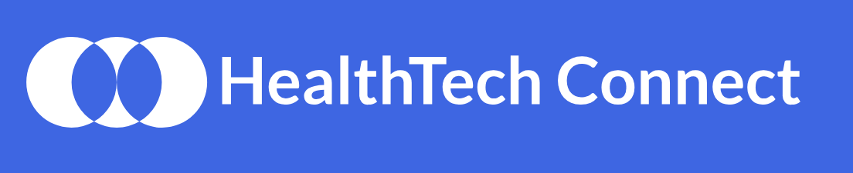
HealthTech Connect
A secure online system for identifying and supporting all health technologies (devices, diagnostics, apps, and wearables) as they move from inception to adoption in the UK.
A clear and simple point of entry to access support and national evaluation programmes.
Enables timely support to be offered, to help the UK plan for their introduction (eg by reconfiguring services, or enabling reimbursement).
Enables transformative technologies to be identified and fast tracked through relevant processes with the Accelerated Access Collaborative.
First applications are being considered.

Slide 9
Helping to find technologies with plausible promise: reasons for non-selection

Slide 10

Evaluation of digital psychological therapies - IAPT
NICE is evaluating selected, digitally enhanced therapies for depression and anxiety using ongoing data collection to determine whether there are improvements in service efficiency, and whether patient outcomes are at least as good as those achieved by NICE recommended, non-digital therapy.

Slide 11
Assessment process
Step 1: NHS England identification of potential products – the pipeline
Step 2: NICE assessment for provisional entry into IAPT - an IAPT Assessment Briefing
Step 3: Entry into the IAPT Programme and ongoing data collection
Step 4: NICE analysis of data on a quarterly basis, with final review after 2 years

Slide 12

Future assessment of digital technologies
NICE will use and promote the new Evidence Standards Framework, which is designed to:
Provide advice to digital health innovators about how the NHS makes decisions and the standards of evidence they will be expected to produce for different types of digital technologies
Facilitate a more dynamic, value driven approach to developing and commissioning digital health technologies that offer real value to patients
Test evaluation of selected digital technologies.

Slide 13
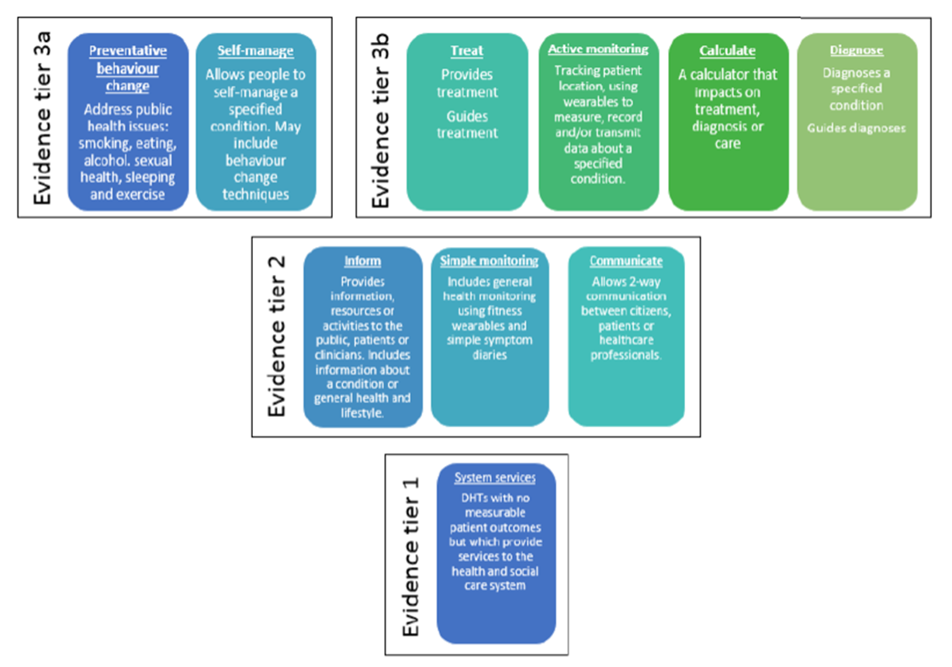

Slide 14




Monitoring and supporting uptake
Innovation scorecard:
Alignment with clinical areas and links with Getting it Right First Time
Case for redevelopment under way as joint work between NHS Digital, OLS and NICE
Impact reports:
Publishing 6 a year, on various clinical topic areas.

Slide 15
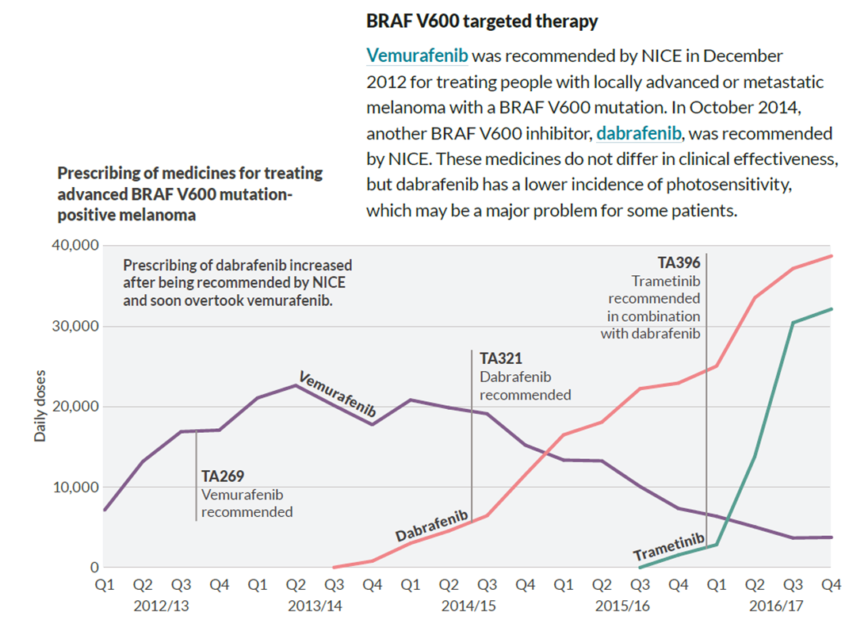
Uptake of new drugs for melanoma

Slide 16
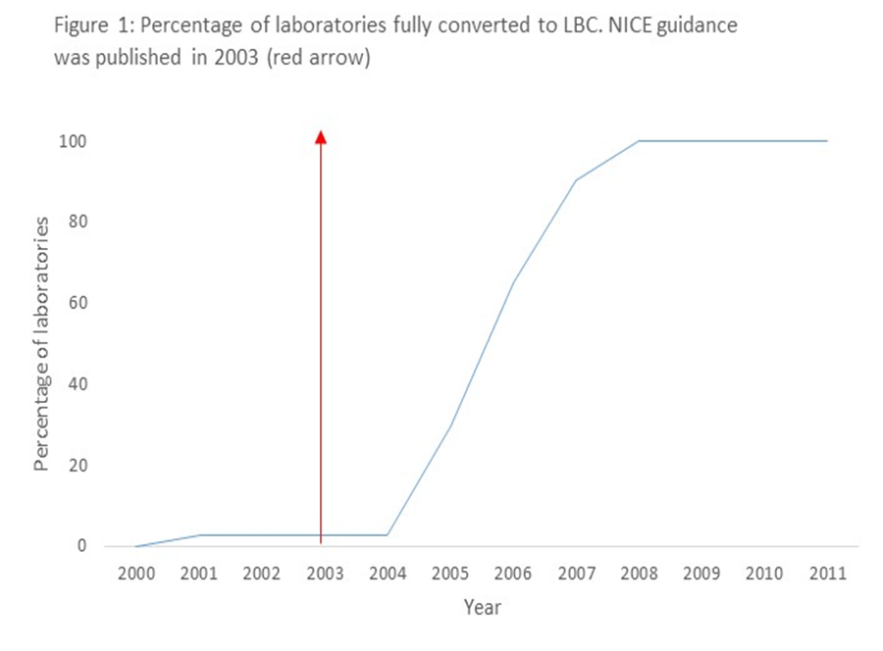
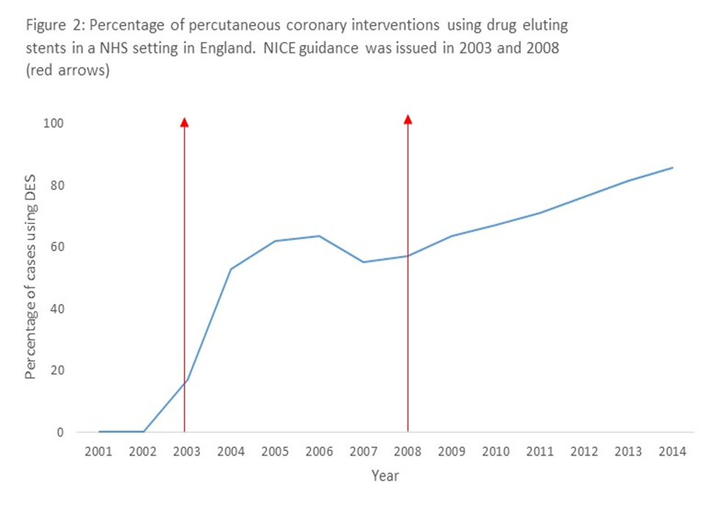
Uptake of recommended technologies Report in BMJ Innovations
Percentage of laboratories fully converted to LBC. NICE guidance was published in 2003 (red arrow)
Percentage of percutaneous coronary interventions using drug eluting stents in an NHS setting in England. NICE guidance was published in 2003 and 2008 (red arrows)

Slide 17
Vision for the future
Recs & evidence summaries
Dissemination – images and videos
Support products e.g. decision aids
New research and data
Updates
New data & evidence
“Our work will be driven by pathways that reflect the way prevention, treatment and care are organised and delivered. These pathways will be the way we prepare and present advice to our users on effectiveness, safety and value for money. The pathways will enable links to be made across topics and within topics, and allow users to access underpinning evidence and practical support”

Slide 18

Benefits of the pathways approach
The overall benefit will be improved care for patients, with better outcomes, as a result of:
Maintaining our recommendations up to date, so care is always based on the best available evidence
Rapid sequencing of new drugs and technologies, so they will be adopted more quickly
More accessible recommendations, so access to NICE advice is quicker and easier
Integrating our recommendations into IT systems, so adherence to evidence-based practice is increased.

